Slide 1




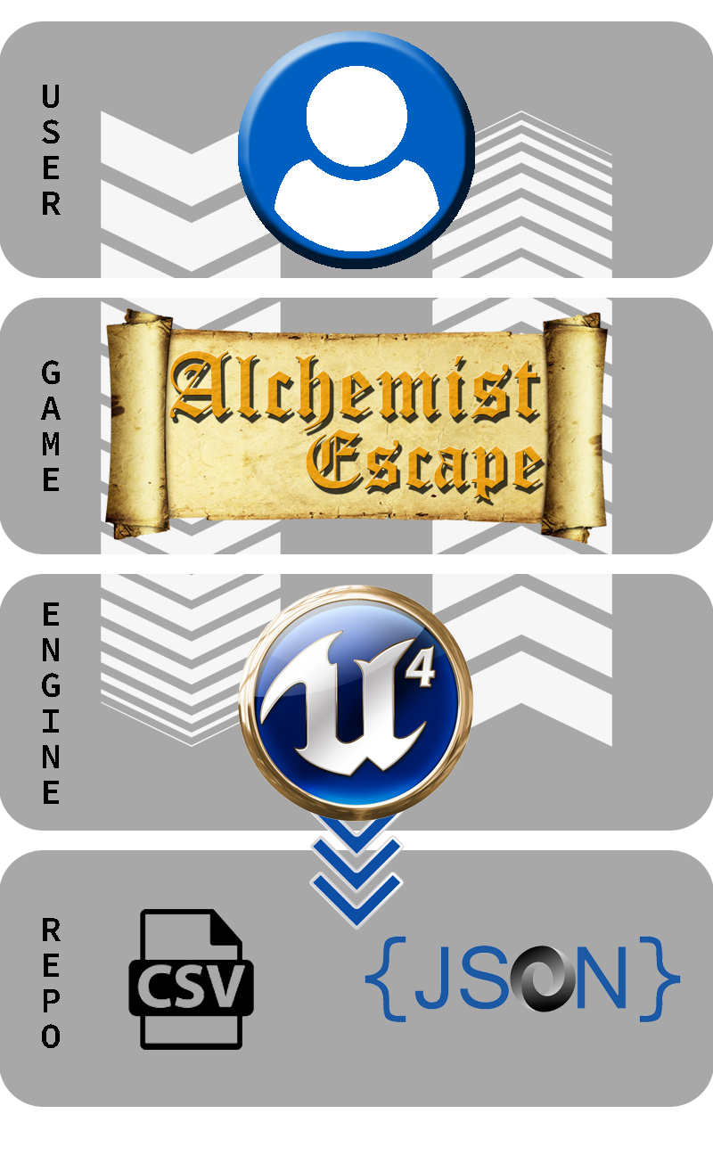
















VR-Gaming to Broad Participation in CS 1.0
VIP Senior, 2018, Spring
Santiago Bolivar
sboli001@fiu.edu
Florida International University
Student
Francisco Ortega
fortega@fiu.edu
Florida International University
Mentor / Professor
Masoud Sadjadi
sadjadi@cis.fiu.edu
Florida International University
Professor
Problem
System Design
Computer Science (CS) is a major in high demand. Yet minorities who have recently graduated from high school do not show much interest in it. The STEM nature of Computer Science tends to challenge the abilities of those who pursue the major.
Solution
We propose “Alchemist Escape”. A complete Virtual Environment video game, which allows players to immerse entirely in a escape room scenario. Each room holds a basic concept of CS while maintaining the entertainment factor of any other video game.
Figure 1: Class Diagram for “Alchemist Escape”
Current System
Educational video games are developed to be instructional or tutorial based. Many of these systems seem to work when the player is interested into playing the game, but they do not invite those that are not interested in the subject.
Figure 5: Gameplay – Top View Array Room
Contribution
Figure 2: System Diagram for “Alchemist Escape”
Initial State
Modeling
3D Object Creation
Materials/Textures
Game Engine
Environment Creation
Object Placement
Logic
Environment Responses
3D Object Optimization
World Properties
Setting Actor Functions
Objects Attributes
Game
Testing
Unit Testing
Debugging
Tasks completed for Alchemist Escape:
Logic – Book (object) verification
Logic – Puzzle failure (User Notification)
Logic – Puzzle Completion / Reset
Logic – Achievements
Function – Graber system for PC version
Game Environment Architecture
Testing and Debugging
Possible State
Wrong State
Correct State
Figure 6: Gameplay – Possible States and User Notification
Future Work
Figure 3: Implementation for “Alchemist Escape”
Figure 7: Gameplay – Achievement for Solving Array Puzzle
Planned future work for Alchemy Escape:
Run Studies
Add More Concepts of CS
Implement full VR
Port into Mobile
Port into Mobile VR
Summary
The purpose behind creating Alchemy Escape is to spark interest on Computer Science. People are more open to play a game rather than attending a class. Moreover, by playing the game and then reinforcing the concepts of Computer Science, the user will be able to connect how everyday tasks can relate to concepts taught on Computer Science.
Copyright © 2018 - OpenHID – http://OpenHID.com
Research material and support made possible by Dr. Francisco Ortega.
Thanks to my family for all the support, My teammates Daniel Perez and Armando Carrasquillo, My girlfriend Paola Jiron and friends Alban Delamare, Ray Chang-Lau and, Hamilton Chevez.
Follow us at @FIUCIS
Notes:
1

